Slide 1
SWEG2071
Web Design and Programming
SWENG
AASTU
May 2018

Slide 2
Chapter 6
Server Side Programming

Slide 3
Outline
Introduction
Basic PHP Syntax
Setting up webserver with PHP
Using Numbers and Strings in PHP
Conditional and Loop Statements
Arrays and Functions in PHP
Retrieve Data from HTML Forms
Files
Session and Cookie Management in PHP
Connecting to Database

Slide 4
Server Side Scripting
Scripts (programs) are stored on the server and are executed on request (from a client).
Result of execution is sent to the client in the form of HTML.
The server side script/program itself is never returned to the client!
May be written in a wide variety of programming/scripting languages.
  PHP, ASP.NET, Java servlet, PERL …
Can perform several powerful operations.

Slide 5
What is PHP?
PHP(Hypertext Preprocessor) is a server-side scripting language whose scripts are embedded in HTML documents.
A powerful tool for making dynamic and interactive Web pages
PHP is an open source and platform independent.
Supports (almost) all major databases (MySQL, MS SQL Server, Oracle, Sybase, Solid, PostgreSQL, etc.)
Current version: PHP 7

Slide 6
Set Up PHP on Your Own PC
Install PHP, free to download from the official PHP resource: www.php.net.
install a web server(Apache/IIS): software that listens for requests and returns data, download from http://httpd.apache.org/download.cgi
install a database, such as MySQL
All-in-One packages
  XAMPP runs on every operation system.
    X-OS (any Operating System), Apache (web-server), MySQL (database), PHP (language), PERL (language)
  WAMP runs only on Windows.
    Windows (OS), Apache (web-server), MySQL (database), PHP (language).
  LAMP Server(Linux, Apache, MySQL, PHP)

Slide 7
XAMPP
Download: https://www.apachefriends.org/download.html
Collision with other Web Server:
  There may be WAMP or IIS installed too
  The best solution is to change the port
  From the Tray Icon, left click and
    Go to .\apache\conf -> httpd.conf
    Search for “Listen 80”
    Replace with “Listen 8080” for example
    Access http://localhost:8080/
XAMPP Directories
  ./htdocs – location of public html files
  ./apache – location of configuration
  ./mysql – location of MySQL database

Slide 8
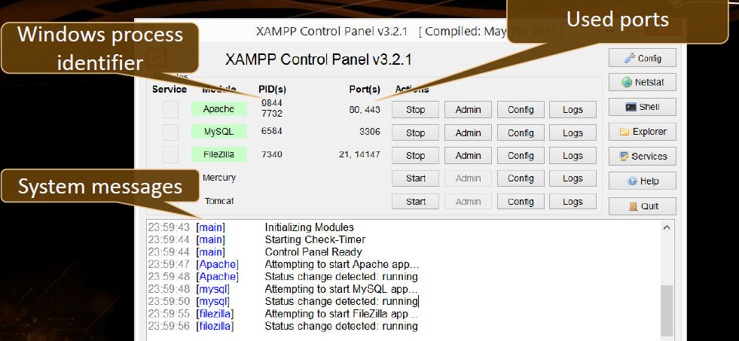
XAMPP(cont’d)

Slide 9
XAMP(cont’d)
When you want to work on PHP code you need to start Apache/MySQL on the XAMPP control panel
Save all of your PHP documents into the htdocs folder with the file extension .php
PHP files can be inside subfolders of htdocs
Run your PHP file by browsing to http://localhost/foldername
The default page (home page) of each folder is index.php
If you want to view a page with a different name, open http://localhost/foldername/pagename.php

Slide 10
PHP – Language Basics
A PHP script always starts with <?php and ends with ?>.
A PHP script can be placed anywhere in the document.
Each code line in PHP must end with a semicolon.
A PHP file contains HTML tags, and some PHP scripting code, saved using extension .php.
Below, we have an example of a simple PHP script that sends the text "Hello World" back to the browser:
      <html>
      <body>
      <?php
      echo "Hello World";
      ?>
      </body>
      </html>

Slide 11
PHP – Language Basics
Every variable name begins with a $
  Case sensitive
  E.g. $pi, $area, $calc_total, $year2018
There are two basic statements to output text with PHP: echo and print.
Comments - three different kinds (Java and Perl)
  // ... Single line
  # ...
  /* ... */

Slide 12
Data Types
Boolean (bool or boolean)
  Can be either TRUE or FALSE
Integer (int or integer)
  Hold integer values (signed or unsigned)
Floating point (float or double or real)
  Hold floating point values
String (string)
  Hold strings of characters within either ‘ or “
  Escaping of special characters can be done using \
  E.g. “this is a string”, ‘this is another string’, “yet \”another\” one”

Slide 13
Data Types(cont’d)
Array
  Collection of values of the same data type
Object
  Instance of a class
Resource
  Hold a reference to an external resource created by some functions
NULL
  Represents that a variable has no value
  A variable is considered to be NULL if
    it has been assigned the constant NULL.
    it has not been set to any value yet.

Slide 14
Strings
Characters are single bytes
String literals use single or double quotes
Single-quoted string literals:
  Embedded variables are NOT interpolated and embedded escape sequences (such as \n) are NOT recognized.
  suppose $sum = 10.2
Double-quoted string literals:
  Embedded variables ARE interpolated and embedded escape sequences ARE recognized
  if the current value of $sum is 10.2:
String concatenation: Use the . (dot) operator. Example:
      <?php
      $var1 = “Today is “;
      $message = $var1 . date(“d-m-Y”);
      echo $message //Today is 15-05-2018
      ?>
‘The sum is: $sum’
is exactly as it is typed.
“The sum is: $sum”
is The sum is: 10.2

Slide 15
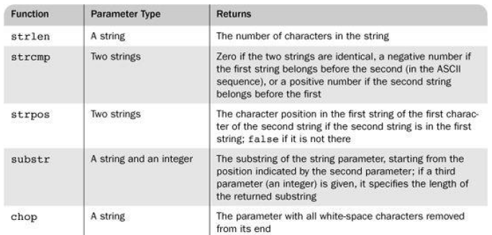
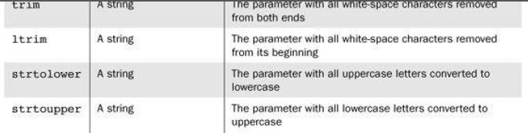
Predefined String Functions

Slide 16
Operators
Arithmetic
  +, -, *, /, %, --, ++
Assignment (simple, compound)
  =, +=, -=, *=, /=, %=
Comparison
  ==, != , ===, !==, <, >, <=, >=
Logical
  &&, || , !

Slide 17
Control Structures
Conditional
  If … else
  Switch
Looping
  For loop, while and do-while loop
  Foreach
    foreach ($array_name as $value) { code here }
  Example:
      $x = 2;
      while ($x < 1000) {
      echo $x . “\n”; // \n is newline character
      $x = $x * $x;
      }

Slide 18
Arrays
An array holds a group of values, which you can identify by position (a number, with zero being the first position) or some identifying name (a string), called an associative index:
  $person[0] = "Edison";
  $person[1] = "Wankel";
  $person[2] = "Crapper";
  $creator['Light bulb'] = "Edison";
  $creator['Rotary Engine'] = "Wankel";
  $creator['Toilet'] = "Crapper";

Slide 19
Arrays(cont’d)
Use the array() construct, which takes one or more key=>value pairs as parameters and returns an array of them
  The keys are non-negative integer literals or string literals
  The values can be anything
$list = array(); //creates empty array
$list = array(17, 24, 45, 91);
//creates traditional array, keys 0, 1, 2, and 3.
$list = array(1 => 17, 2 => 24, 3 => 42, 4 => 91); //different keys
$ages = array(“Joe” => 42, “Mary” => 41, “Bif” => 17); // a form of hash

Slide 20
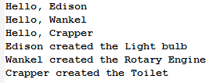
Arrays(cont’d)
There are several ways to loop through arrays, but the most common is a foreach loop:
E.g.
  $person = array("Edison", "Wankel", "Crapper");
  $creator = array('Light bulb' => "Edison",
  'Rotary Engine' => "Wankel",
  'Toilet' => "Crapper");
  foreach ($person as $name) {
  echo "Hello, {$name}\n";
  }
  foreach ($creator as $invention => $inventor) {
  echo "{$inventor} created the {$invention}\n";
  }

Slide 21
Functions Dealing with Arrays
An array can be deleted with unset
is_array($list) returns true if $list is an array
in_array(17, $list) returns true if 17 is an element of $list
explode(" ", $str) creates an array with the values of the words from $str, split on a space
  E.g. $fruitString = “apple,pear,banana,strawberry,peach”;
        $fruitArray = explode( “,”, $fruitString );
        Print_r($ fruitArray ); ///prints out information about a variable
    Output: Array ( [0] => apple [1] => pear [2] => banana [3] => strawberry [4] => peach )
$list = array(2, 4, 6, 8);
unset($list[2]); // remaining elements with keys 0, 1, and 3 and //elements 2, 4, and 8.
Unset($list); delete whole array

Slide 22
Function Dealing with Arrays(cont’d)
implode(" ", $list) creates a string of the elements from $list, separated by a space
  E.g. $fruitArray = array( “apple”, “pear”, “banana”, “strawberry”, “peach” );
  $fruitString = implode( “,”, $fruitArray );
echo $fruitString; // Output: “apple,pear,banana,strawberry,peach”
Sorting Arrays
  sort($array) : Sorts an array in ascending value order
  rsort($array) : Sorts an array in descending value order
  asort($array) : Sorts an array in ascending value order while maintaining the key/value relationship
  arsort($array) : Sorts an array in descending value order while maintaining the key/value relationship
  ksort – to sort given array by keys rather than values

Slide 23
Function Dealing with Arrays(cont’d)
Example 1:
  $flavors[] = ‘blue raspberry’;
  $flavors[] = ‘root beer’;
  $flavors[] = ‘pineapple’;
  sort($flavors); // Array ( [0] => blue raspberry [1] => pineapple [2] => root beer )
  print_r($flavors); //prints out information about a variable
  rsort($flavors); // Array ( [0] => root beer [1] => pineapple [2] => blue raspberry )
  asort($flavors); // Array ( [0] => blue raspberry [2] => pineapple [1] => root beer )
  Example 2
  $creator['Toilet'] = "Crapper";
  $creator['Rotary Engine'] = "Wankel";
  $creator['Light bulb'] = "Edison";
  ksort($creator);
  print_r($creator); //Array ( [Light bulb] => Edison [Rotary Engine] => Wankel [Toilet] => Crapper )

Slide 24
Functions
Format:
<?php
function function_name($arg_1, $arg_2, ..., $arg_n) {
function body
[return $retval;]
}
?>
  Example:
        function multiply($x, $y) {
        echo $x * $y;
        echo “\n”;
        }

Slide 25
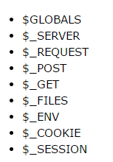
PHP 5 Global Variables - Superglobals
Built-in variables that are always available in all scopes.
Always $_ALLCAPS
The $_SERVER superglobal gives information about server and client
  $_SERVER[‘SERVER_ADDR’] → server IP
  $_SERVER[‘REMOTE_ADDR’] → client IP
  $_SERVER[‘HTTP_USER_AGENT’] → client OS and browser

Slide 26
Form Handling
Forms could be handled with PHP:
  PHP script embedded in an HTML document
  Separate PHP document
    A separate document to handle the form can be specified as the value of the action attribute
The PHP $_GET and $_POST variables are used to retrieve information from forms.
  $_GET variable is used to collect values in a form with method="get".
  $_POST variable is used to collect values from a form sent with method="post".

Slide 27
Example: get
GET request: pass information via the URL
  http://www.yourdomain.com/yourpage.php?firstparam=firstvalue&secondparam=secondvalue
HTML Form
  <form action="welcomeget.php" method="get">
  Name: <input type="text" name="fname">
  Age: <input type="text" name="age">
  <input type="submit">
  </form>
PHP(welcomegetget.php)
Welcome <?php echo $_GET["fname"]; ?>!<br>
You are <?php echo $_GET["age"]; ?> years old.
  When the user clicks the “submit" button, the URL sent to the server could look something like this:
    localhost/Examples/welcome.php?fname=Peter&age=37
  the "welcome.php" file can now use the $_GET variable to collect form data (the names of the form fields will automatically be the keys in the $_GET array).

Slide 28
Example: post
HTML Form
  <form action="welcomepost.php" method=“post">
  Name: <input type="text" name="fname">
  Age: <input type="text" name="age">
  <input type="submit">
  </form>
PHP (welcomepost.php)
Welcome <?php echo $_POST["fname"]; ?>!<br>
You are <?php echo $_POST["age"]; ?> years old.
When the user clicks the “submit" button, the URL sent to the server could look something like this:
  localhost/Examples/welcome.php
the "welcome.php" file can now use the $_POST variable to collect form data (the names of the form fields will automatically be the keys in the $_GET array):

Slide 29
Example: _REQUEST
$_REQUEST variable contains the contents of both $_GET, $_POST, and $_COOKIE.
The $_REQUEST variable can be used to collect form data sent with both the GET and POST methods.
Example
Welcome <?php echo $_REQUEST["fname"]; ?>!<br>
You are <?php echo $_REQUEST["age"]; ?> years old.

Slide 30
Files
PHP allows you to work with files and directories stored on the Web server.
Opening a file
  The PHP fopen() function is used to open a file. It requires two arguments stating first the file name and then mode in which to operate.
  E.g. $fptr = fopen(filename, use_indicator)
  Because fopen could fail, use it with die
  $file_var = fopen (“test.dat”, “r”) or die (“Error – test.dat can’t be opened”);

Slide 31
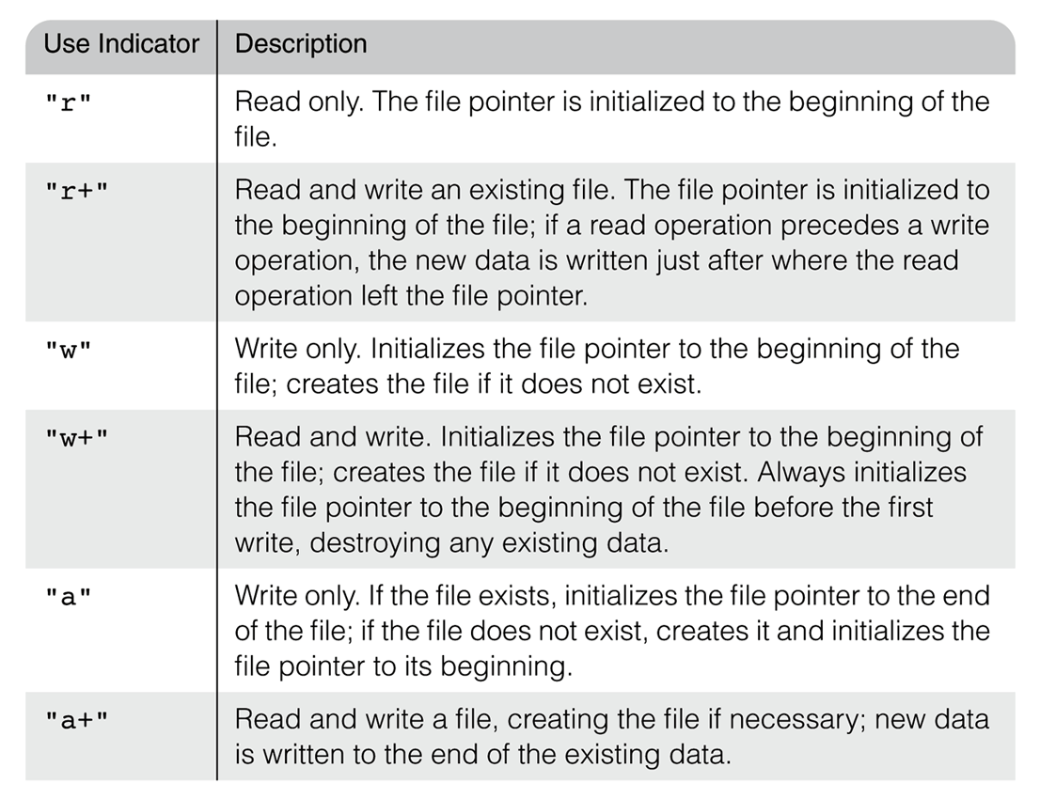
File Use Indicator

Slide 32
Reading From a File
Use file_exists(filename) to determine whether file exists before trying to open it
Use fclose(file_var) to close a file
Reading from a file
  1. Read all or part of the file into a string variable
  $str = fread($file_var, #bytes)
  To read the whole file, use filesize(file_name) as the second parameter
  E.g. $file_string = fread ($file_var, filesize(“test.dat”));
  file_get_contents - alternative to read entire file, no need opening the file, takes file name as param
  E.g. $file_string = file_get_contents(“testdata.dat”);

Slide 33
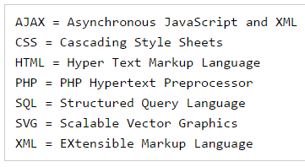
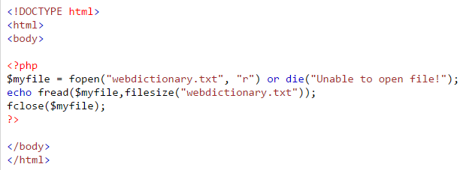
Example
webdictionary.txt

Slide 34
Reading From File(cont’d)
  2. Read the lines of the file into an array
  $file_lines = file(file_name);
  Need not open or close the file unlike fread
  3. Read one line from the file
  $line = fgets(file_var, #bytes)
  Reads characters until eoln, eof, or #bytes characters have been read
  4. Read one character at a time
  $ch = fgetc(file_var)
  Control reading lines or characters with eof detection using feof function (TRUE for eof; FALSE otherwise)
  E.g.
      <?php
      $myfile = fopen("temp.txt", "r+") or die("Unable to open file!");
      while(!feof($myfile)) {
      $ch = fgetc($myfile);
      echo $ch;
      }
      fclose($myfile);
      ?>

Slide 35
Writing to File
A new file can be written or text can be appended to an existing file using the PHP fwrite()function.
This function requires two arguments: a file handle and a string to write to the file
Optionally a third integer argument can be included to specify the length of the data to write. If the third argument is included, writing will stop after the specified length has been reached.
  E.g. $handle = fopen( “data.txt”, “w” );
fwrite( $handle, “ABCxyz” );

Slide 36
Reading Assignment
Uploading File

Slide 37
Cookie
A cookie is a piece of information that’s stored by a server in a text file on a client’s computer to maintain information about the client during and between browsing sessions.
A cookie is sent from the server to the browser as part of the HTTP headers.
A cookie is unique to a particular server:
  Only the server that created a cookie can ever receive the cookie from the browser
Use the setcookie() function to send a cookie to the browser:
  setcookie(name, value, expire, path, domain, secure);

Slide 38
Cookie(cont’d)
In the example below, we will create a cookie named "user" and assign the value "Alex Porter" to it. We also specify that the cookie should expire after one hour:
  <?php
  setcookie("user", "Alex Porter", time()+3600);
  ?>
  You can also set the expiration time of the cookie as follows: $expire=time()+60*60*24*30; // the expiration time is set to a month (60 sec * 60 min * 24 hours * 30 days).

Slide 39
Cookies(cont’d)
Cookies must be created before any other HTML is created by the PHP document, the setcookie() function must appear BEFORE the <html> tag. Because cookies are stored in HTTP header which is sent before the body of the document
Cookies are obtained in a script the same way form values are gotten, using the $_COOKIE array (cookie names as keys & cookie values as values)
  Use IsSet to check if a particular cookie came with the request

Slide 40
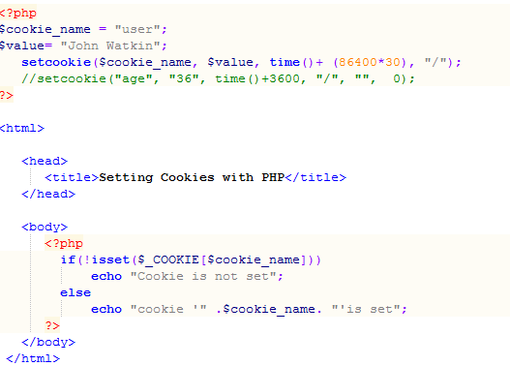
Example

Slide 41
Cookie(cont’d)
How to Retrieve a Cookie Value?
  In the example below, we retrieve the value of the cookie named "user" and display it on a page
  <?php
  // Print a cookie
  echo $_COOKIE["user"];
  // A way to view all cookies
  print_r($_COOKIE);
  ?>

Slide 42
Cookies(cont’d)
How to Delete a Cookie?
  When deleting a cookie you should assure that the expiration date is in the past.
  Delete example
  <?php
  // set the expiration date to one month ago
  setcookie("user", "", time()-(86400*30), "/");
  ?>

Slide 43
Session
A session is the time span during which a browser interacts with a particular server
  Begins when a browser connects to the server
  Ends either:
    When the browser is terminated or
    When the server terminated the session because of client inactivity
A session is identified by a unique session ID.
Unlike cookies they are stored on the server
Starting a PHP Session
  Before you can store user information in your PHP session, you must first start up the session.
  To read/write from/to the session, it should first be initialized by calling the function session_start()
  Note: The session_start() function must appear BEFORE the <html> tag: The function will create a new session if one doesn’t exist already. If a session already exists, all data in it will be available to the current script.

Slide 44
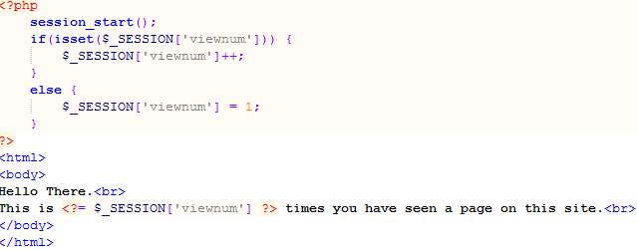

Session(cont’d)
E.g <?php session_start(); ?>
  Will register the user's session with the server, allow you to start saving user information, and assign a UID for that user's session.
Storing a Session Variable
  use the PHP $_SESSION variable to store and retrieve session variable.
Example:

Slide 45
Session(cont’d)
Destroying a Session
If you wish to delete some session data, you can use the unset() or the session_destroy() function.
The unset() function is used to free the specified session variable:
        <?php
        session_start();
        if(isset($_SESSION['viewnum']))
        unset($_SESSION['viewnum']);
        ?>
You can also completely destroy the session by calling the session_destroy() function:
    <?php
    session_destroy();
    ?>

Slide 46
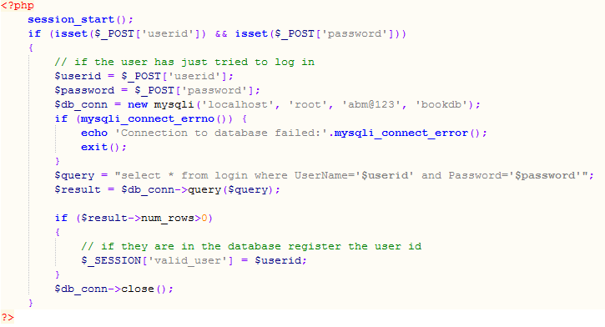
Example: loginauth.php
Create table login with columns “UserName” and “Password”.

Slide 47
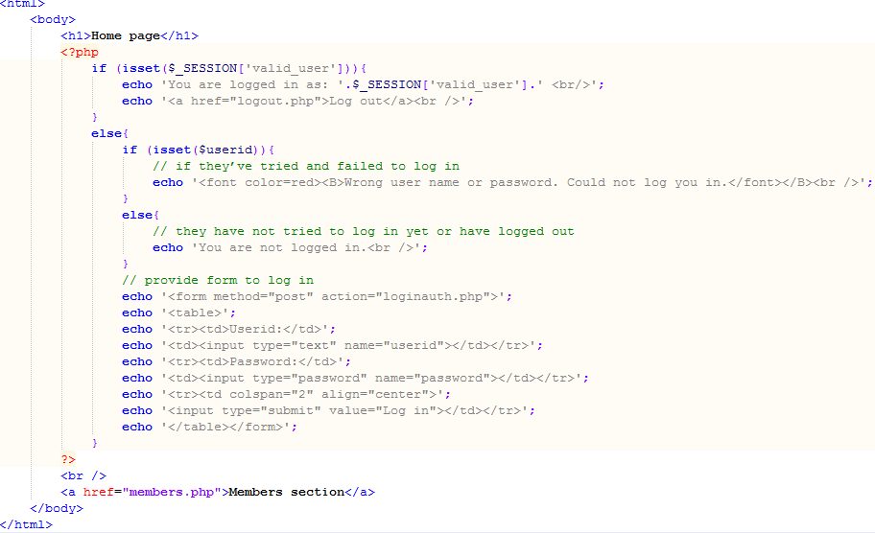
Example: loginauth.php(cont’d)

Slide 48
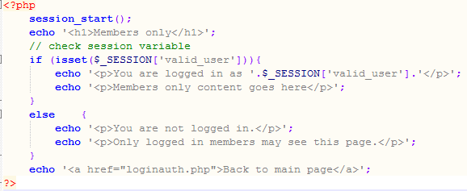
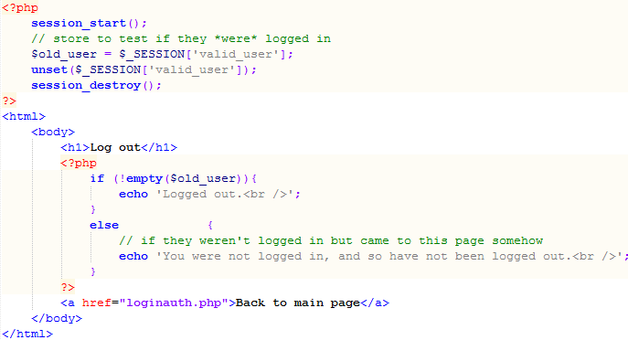
Example: members.php
Example: logout.php

Slide 49
Connecting to Database
One of the defining features of PHP is the ease with which you can connect to and manipulate databases.
PHP implements functions for connecting to a wide range of databases systems: MySQL, Oracle, MSSQL, dBase, and many more.
Two main ways to connect to MySQL databases:
  MySQLi (MySQL Improved)– only work with MySQL databases
    object-oriented, procedural
  PDO(PHP Data Objects) – work on 12 different database systems
    object-oriented

Slide 50
Making Connection
MYSQLi
  $db = mysqli_connect(host, username, password, databaseName);
  $db = new mysqli(host, username, password, databaseName);
  E.g. $db = new mysqli("localhost", “root", “1234", “bookdb");
        if (empty($conn)) {
        //stop execution of a script
        die("mysqli_connect failed: " . mysqli_connect_error());
        }
        print "connected to " . mysqli_get_host_info($db) . "\n";
PDO $conn = new PDO( $dsn, $username, $password );
    $dsn = “mysql:host=localhost;dbname=mydatabase”;
    If host isn ’ t specified, localhost is assumed.
When you’ve finished with the connection, you should close it so that it’s freed up for other scripts to use: mysqli_close($db); or $conn->close();

Slide 51
Specify DB and Querying
Choosing a Database to Use:
  $db->select_db(dbname)
  or as
    mysqli_select_db(db_resource, db_name)
      E.g. mysqli_select_db($db, ‘bookdb')
Querying the Database
  use mysqli_query() function.
  Example:
    $query = "select * from books”;
    You can now run the query:
      $result = $db->query($query);
    Or, if you want to use the procedural interface, you use
      $result = mysqli_query($db, $query);

Slide 52
Retrieving the Query Results
The result object or identifier is the key to accessing the rows returned by the query.
num_rows: stores the number of rows returned. Specified as: $num_results = $result->num_rows; or
$num_results = mysqli_num_rows($result); //procedural
There are three ways to fetch rows of results:
      $row = $result->fetch_assoc(); Or
      $row = mysqli_fetch_assoc($result);
      $row = $result->fetch_row($result); Or $row = mysqli_fetch_row($result);
      $row = $result->fetch_object(); Or $row = mysqli_fetch_object($result);
      //Read the difference between the three

Slide 53
Disconnecting from the Database
You can free up your resultset by calling either
  $result->free();
  Or mysqli_free_result($result);
You can then use:
  $db->close();
  Or mysqli_close($db);

Slide 54
Example
Create database bookdb
Create table book(ISBN, Author, Title, Price)
Insert values to the table
Display the content

Slide 55
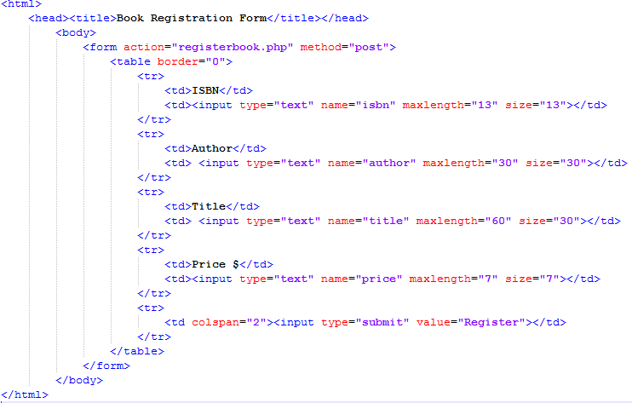
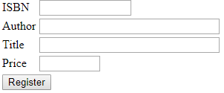
Example1: registerbook.html

Slide 56
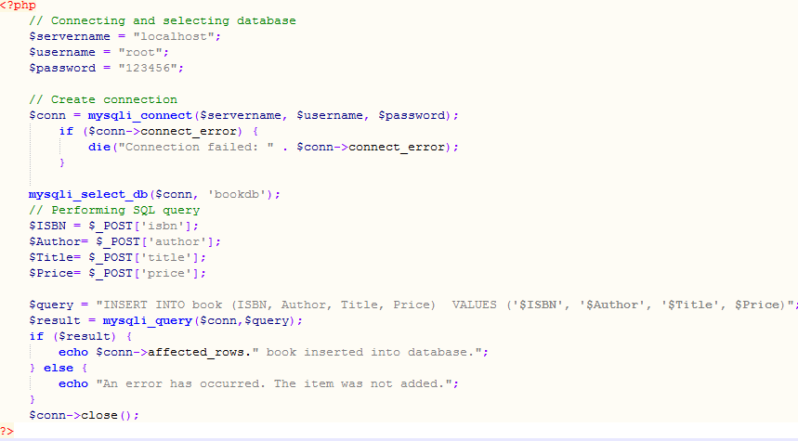
Example1: registerbook.php

Slide 57
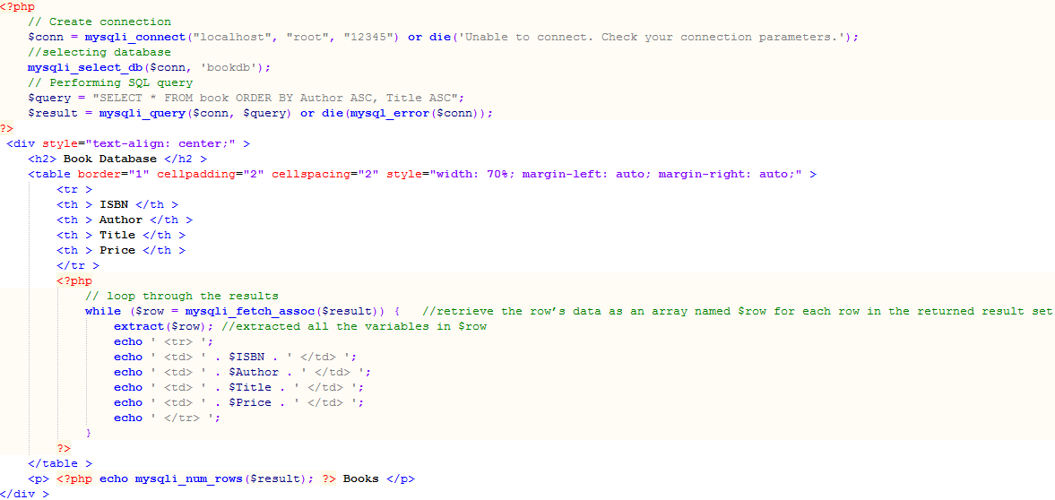
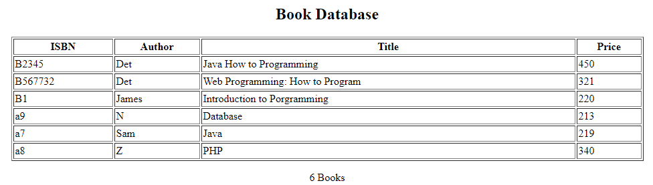
Example2: retrievebookinfo.php
dd

Slide 58
Directory Listing (XAMPP)
Open httpd.conf, then in directory section(<Directory "C:/xampp/htdocs">:
  Enable/Disable Directory Listing
    To Enable directory access add: Options +Indexes
    To disable directory access: Options -Indexes
  Ignore Files with specific extension
    IndexIgnore *.zip *.txt
  Modify Index File(by default it displays Index)
    DirectoryIndex Home.html

